Slide 1
Growth & Allocation
March 19, 2019

Slide 2
Why do plants grow?

Slide 3
Ontogeny

Slide 4
Ontogeny
Development of an organism within its own lifetime

Slide 5
Ontogeny
Ontological development varies by species
(e.g., annuals and perennials)
Ambrosia triffida (Giant ragweed)
Sequoiadendron giganteum (Giant redwood)

Slide 6
Why grow fast and die young?
Ambrosia triffida (Giant ragweed)

Slide 7
Why grow slow and live long?
Sequoiadendron giganteum (Giant redwood)

Slide 8
Allocation

Slide 9
Allocation
The distribution of growth to different organs
Allometry: the relative size of different organs
High leaf allocation
High stem allocation

Slide 10
Following the carbon

Slide 11
CO₂
Carbon is first taken up by photosynthesis (source)

Slide 12
The sugars are then transported throughout the plant (sinks)

Slide 13
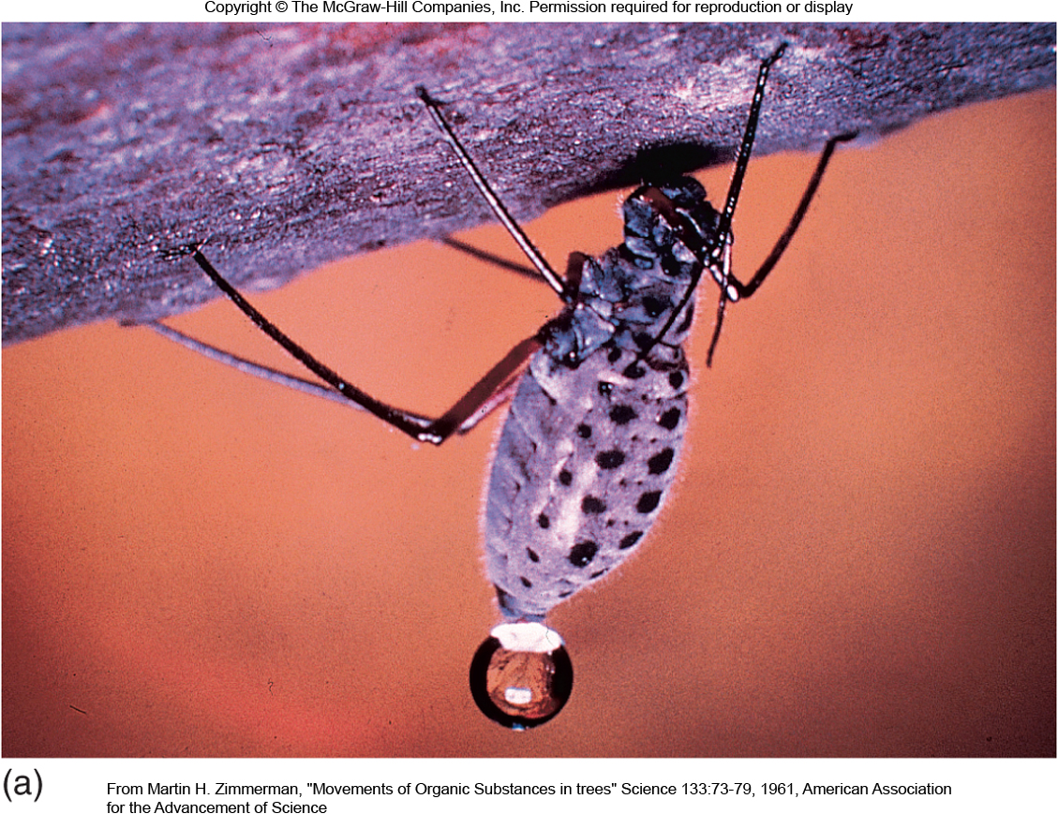
Translocation
Movement of food substances through the plant (via water)
Translocation happens fast!
(Can’t be accounted for by diffusion alone)

Slide 14
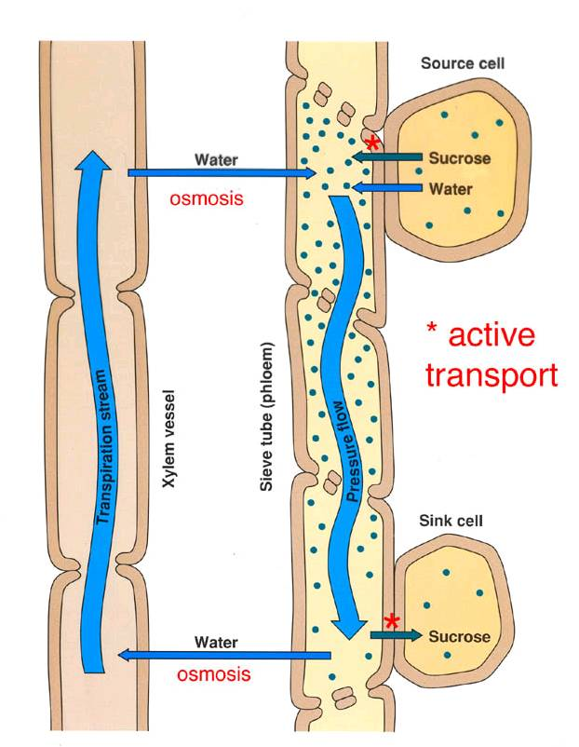
Pressure-flow hypothesis
Food is actively loaded into phloem from “source”
Water enters phloem from xylem via osmosis
Pressure gradient drives food to “sink”
Food is actively removed from sink

Slide 15
What does the carbon get used for? (What are the sinks?)

Slide 16
In isolation, how would abiotic conditions influence allocation?
Light
Temperature
Water
CO₂
Nutrients

Slide 17
In isolation, how would life history traits influence allocation?
Lifespan
Ontogeny
Photosynthetic pathway
Microbial symbiosis

Slide 18
Source/sink

Slide 19
competition

Slide 20
Class activity: the Invader
Pretend you are a species of plant
Pick your dream place to live/invade
What growth and reproductive strategy will you adopt?
Things to think about:
What is the environment like?
Natural enemies?
Competitors?
What kind of flowers/seeds?

Slide 21
NASA

